Slide 1


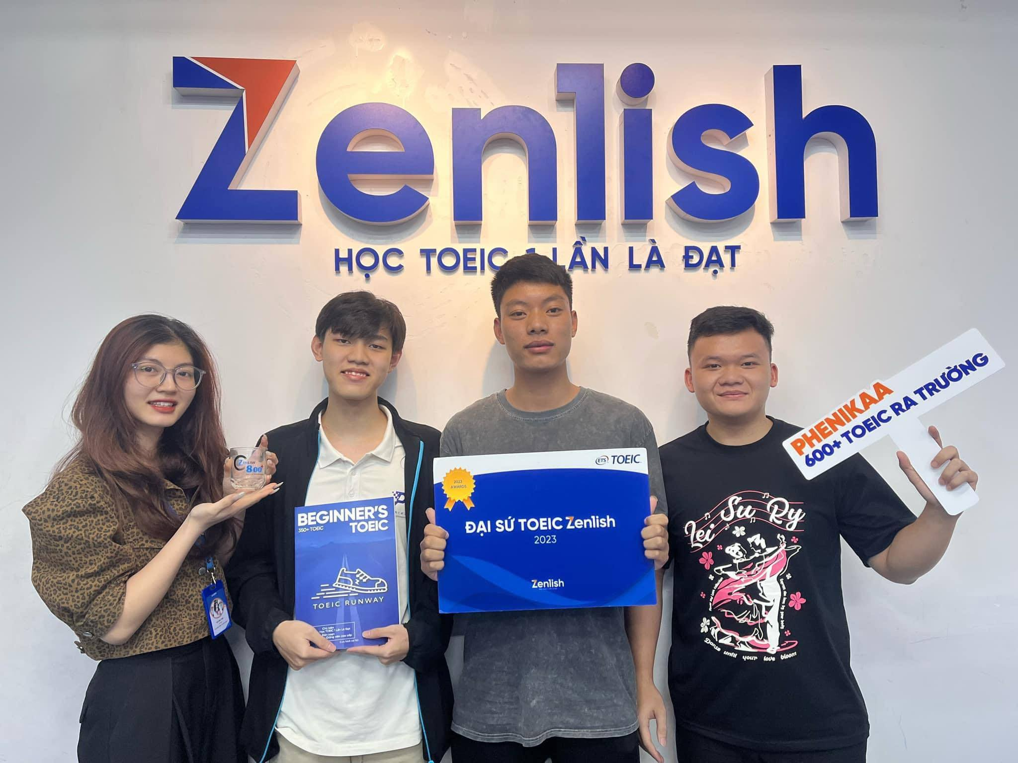
ZENLISH – HỌC TOEIC 1 LẦN LÀ ĐẠT
BEGINNER’S TOEIC
LESSON 10

Slide 2
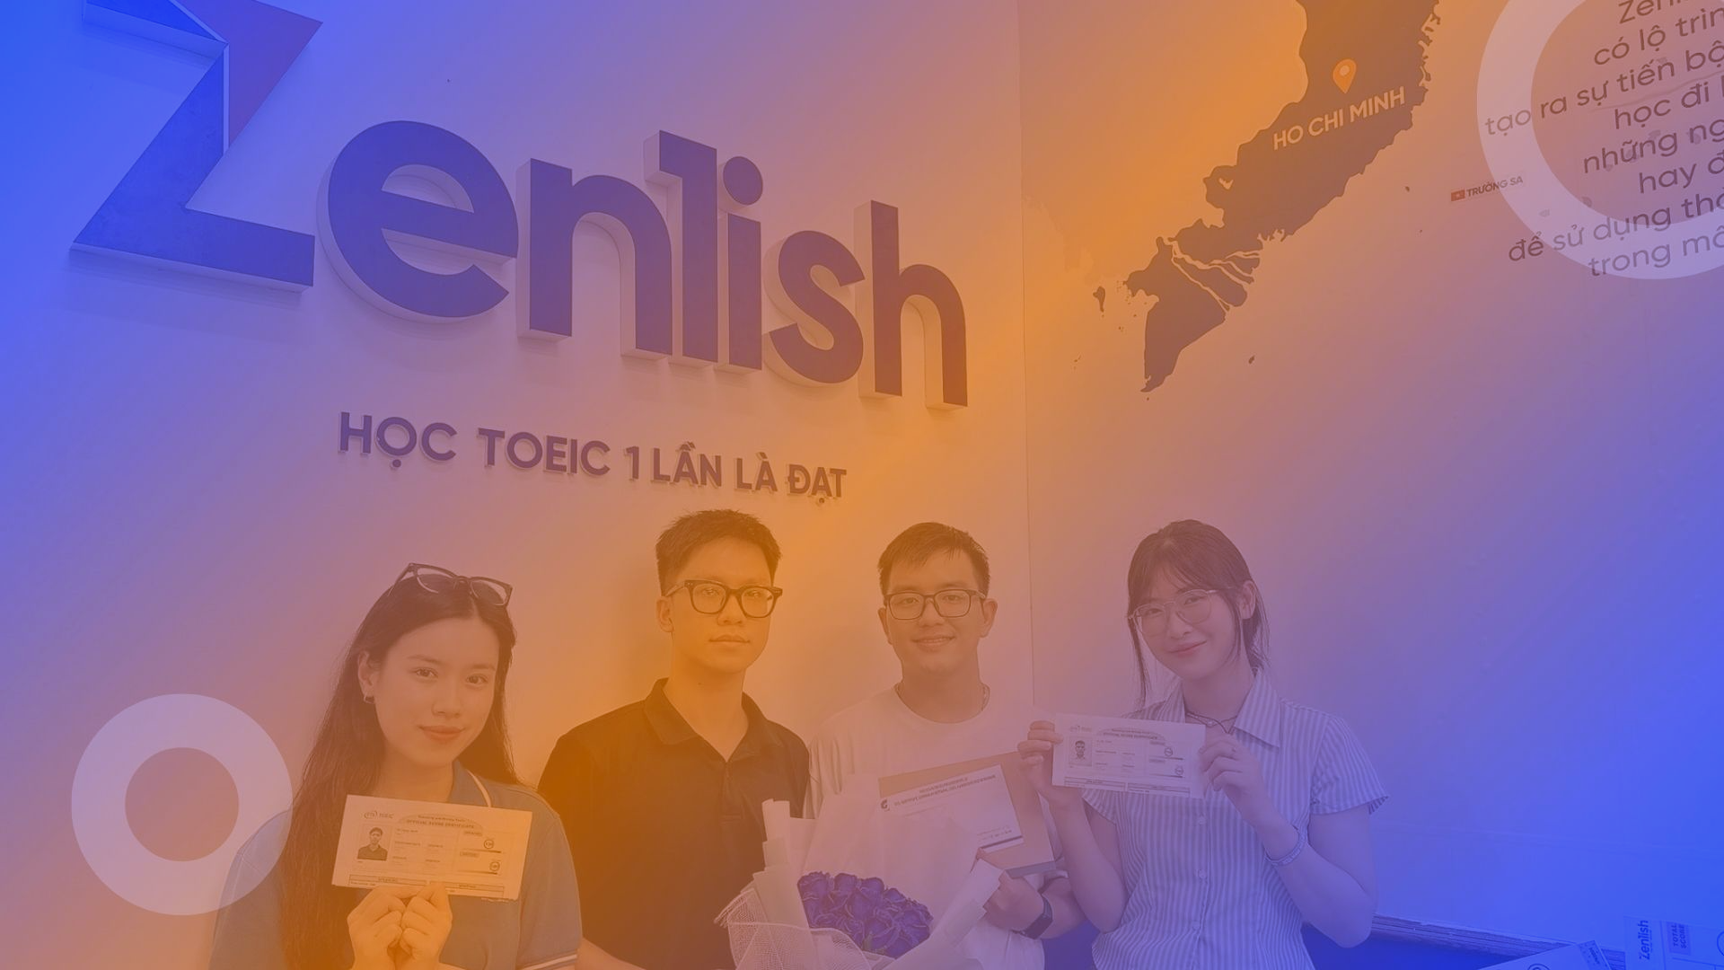


ZENLISH – HỌC TOEIC 1 LẦN LÀ ĐẠT
BEGINNER’S TOEIC
LESSON 10
THỰC HÀNH PART 4 (1)

Slide 3


1
1
What will the company do beginning on June 1?
A. Accept reservations online
B. Provide service to a new location
C. Offer a customer loyalty program
D. Lower its express shipping rates
W-Am: You have reached customer service at (1) ....................... ....................... -a leader in (2) ....................... ....................... ........................ We're happy to announce that starting June first, we'll begin offering (3) ....................... ....................... to Brazil. Note that if you are planning to (4) ......................... ……….... ........................ to any location overseas, you must provide proof of ownership. Your call may be recorded, and the recording could be used for (5) ....................... ....................... or training purposes. Thank you for calling Ocean Shipping.
Ocean Shipping
2
international shipping services.
According to the speaker, what must customers do in order to ship a vehicle?
shipping services
A. Show proof of ownership
B. Provide an extra set of keys
C. Purchase additional insurance
D. Get a mechanical inspection
ship a vehicle
3
What does the speaker indicate about the call?
quality control
A. It will be redirected to a different department.
B. It will be answered in the order in which it was received.
C. It may be several minutes until a representative answers.
D. It may be recorded for future use.

Slide 4

VOCABULARY
customer loyalty program /ˈkʌs.tə.mɚ ˈlɔɪ.əl.ti ˈproʊ.ɡræm/ (n): chương trình khách hàng thân thiết
express shipping rate /ɪkˈspres ˈʃɪp.ɪŋ reɪt/ (n): mức phí vận chuyển nhanh
insurance /ɪnˈʃʊr.əns/ (n): bảo hiểm
mechanical inspection /məˈkæn.ɪ.kəl ɪnˈspek.ʃən/ (n): kiểm tra kỹ thuật cơ khí
redirect /ˌriː.dɪˈrekt/ hoặc /ˌriː.daɪˈrekt/ (v): chuyển hướng, đổi hướng
vehicle /ˈviː.ə.kəl/ (n): phương tiện, xe cộ
ownership /ˈoʊ.nɚ.ʃɪp/ (n): quyền sở hữu
quality control /ˈkwɑː.lə.t̬i kənˈtroʊl/ (n): kiểm soát chất lượng.

Slide 5
1
2
Why is the speaker calling?
A. To schedule a meeting
B. To ask for an e-mail address
C. To provide an invoice number
D. To review employee training plans
W-Am: Hi, Ms. Lee. I’m calling to give you some information about the (1) ....................... ....................... ....................... since today is Angelo's last day in the office. As you suggested, Mariko will be (2) ....................... ....................... his job responsibilities. I had asked Angelo to (3) ....................... ............... to create invoices, but there's a team meeting this afternoon. So I decided to meet with her tomorrow and review the (4) ………………………. ………………………… with her myself. Let me know if you or the other (5) ....................... ..................... have any questions. Bye.
staffing transition plan
2
What does the speaker mean when she says, "there's a team meeting this afternoon"?
taking over
A. She will be late to another meeting.
B. Materials need to be prepared.
C. A staff member is busy.
D. A project has already been completed.
train her
invoice process
3
department managers
What will the speaker do tomorrow?
A. Meet with Mariko
B. Attend a party for Angelo
C. Finish a proposal
D. Print a set of documents

Slide 6
VOCABULARY
Schedule /ˈʃedʒ.uːl/ (n): lịch trình; (v): lên lịch
Invoice /ˈɪn.vɔɪs/ (n): hóa đơn
Provide /prəˈvaɪd/ (v): cung cấp
The staffing transition plan /ðə ˈstæf.ɪŋ trænˈzɪʃ.ən plæn/ (n): kế hoạch chuyển đổi nhân sự
Take over /teɪk ˈoʊ.vɚ/ (phr.v): tiếp quản, đảm nhận
Responsibility /rɪˌspɑːn.səˈbɪl.ə.t̬i/ (n): trách nhiệm, bổn phận.

Slide 7
1
3
At which event is the announcement being made?
A.A book fair
B. A product launch
C. A technology conference
D. A charity fundraiser
W-Br: Good morning, everyone! We hope you've been enjoying the conference on (1) ......................... ......................... this week. Tomorrow, in addition to our workshops and presentations, you'll have the option of leaving the convention center to (2) ............ ............. one of the site visits we've arranged. There are two choices. You can (3) ............... either a local high school or the public library's (4) ......................... ......................... . These tours are free, and we expect them to be very popular. We have limited seats on the buses, so please make sure to (5) ................................ at the desk by the entrance.
educational technology
2
According to the speaker, what can some
listeners do tomorrow?
go on
A. Go on a tour
B. Attend an opening ceremony
C. Participate in a focus group
D. Win a prize
tour
computer laboratory
3
What are the listeners instructed to do?
sign up early
A. Use an alternate entrance
B. Register in advance
C. Complete a survey
D. Meet at a designated location

Slide 8
VOCABULARY
Product launch /ˈprɑː.dʌkt lɑːntʃ/ (n): sự ra mắt sản phẩm
Charity fundraiser /ˈtʃer.ə.t̬i ˈfʌnd.reɪ.zɚ/ (n): sự kiện gây quỹ từ thiện
Ceremony /ˈser.ɪ.mə.ni/ (n): lễ
Participate /pɑːˈtɪs.ɪ.peɪt/ (v): tham gia
Alternate /ˈɒl.tə.neɪt/ (adj): thay thế
Register /ˈredʒ.ɪ.stər/ (v): đăng kí = sign up
In advance: trước
Survey /ˈsɜː.veɪ/ (n): khảo sát
Designated /ˈdez·ɪɡˌneɪ·t̬ɪd/ (adj): được chỉ định
Educational technology: công nghệ giáo dục
Presentation /ˌprez.ənˈteɪ.ʃən/ (n): bài thuyết trình
Convention /kənˈven.ʃən/ (n): hội nghị
Laboratory /ləˈbɒr.ə.tər.i/ (n): phòng thí nghiệm, phòng máy

Slide 9
1
4
Who most likely is the speaker?
A. An investment banker
B. A city official
C. A food scientist
D. A restaurant manager
M-Cn: Before we open the café today, I want to tell you about some (1) ..................... ...................... ..................... I just got word from corporate headquarters that (2) ......................... ......................... will be on the menu starting next week. One of the (3) ........................... is called Winter Delight. I’ve got some samples of it here for everyone to try. Now, a number of different syrup flavors, such as vanilla or hazelnut, can be added to this drink. So please be (4) ........................... when you're (5) ................................. customers' orders. We want to make sure they get exactly what they want.
seasonal menu changes
2
new coffee beverages
new drinks
According to the speaker, what will happen next week?
A. Some new equipment will be installed.
B. A corporate office will relocate.
C. New menu items will be available.
D. Seasonal employees will begin work.
extra careful
3
preparing
What does the speaker warn listeners about?
A. Preparing orders carefully
B. Wearing proper attire
C. Recording hours accurately
D. Taking inventory daily

Slide 10
VOCABULARY
city official /ˈsɪt̬.i əˈfɪʃ.əl/ (n): quan chức thành phố
Equipment /ɪˈkwɪp.mənt/: thiết bị
Relocate /ˌriː.ləʊˈkeɪt/: di chuyển, di dời vị trí
Proper /ˈprɒp.ər/: thích hợp, phù hợp
Attire /əˈtaɪər/: trang phục
Accurately /ˈæk.jə.rət.li/: chính xác
Take inventory /teɪk ˈɪn.vən.tɔːr.i/: kiểm kê hàng hóa
Headquarters /ˌhedˈkwɔː.təz/ : trụ sở chính
Beverage /ˈbev.ər.ɪdʒ/: đồ uống
Sample /ˈsɑːm.pəl/: mẫu thử

Slide 11
1
5
What industry does Janet Colthrup work in?
A. Event planning
B. Accounting
C. Tourism
D. Interior design
M- Cn: Thank you for attending tonight ' s Fredrickstown Business Seminar. I’m excited to introduce our first speaker, Ms. Janet Colthrup. She's the (1) ......................... of Colthrup (2) .......................... Her company specializes in international tax preparation and does business in more than twenty countries. Today she'll share some of the (3) ......................... she used when she (4) .............. ................... ten years ago, working from her home. As we've done in previous sessions, if you have questions for our speaker, please (5) ............... ............. on the cards provided on your seat. Seminar volunteers will collect these questions throughout the session and then give them to the speaker directly. Without further delay, please help me welcome Janet Colthrup.
founder
Accounting
2
What will Janet Colthrup discuss?
A. Tips for starting a business
B. Strategies for international trade
C. Modern home-decorating styles
D. Effective speech-writing techniques
strategies
started her firm
3
write them
What does the speaker request that listeners do?
A. Take a handout before they leave
B. Submit their questions in writing
C. Move to the empty seats in the front
D. Split into small discussion groups

Slide 12
VOCABULARY
Tourism /ˈtʊə.rɪ.zəm/ (n): nghề du lịch
Interior /ɪnˈtɪə.ri.ər/ (n): phần bên trong, nội thất
Strategy /ˈstræt.ə.dʒi/ (n): chiến lược
Decorate /ˈdek.ə.reɪt/ (v): trang trí
Technique /tekˈniːk/ (n): kỹ thuật
Effective /ɪˈfek.tɪv/ (adj): hiệu quả
Handout /ˈhænd.aʊt/ (n): tài liệu
Split /splɪt/ (v): chia ra
Specialize /ˈspeʃ.əl.aɪz/ (v): chuyên về
International tax preparation: kê khai thuế quốc tế
Previous /ˈpriː.vi.əs/ (adj): trước (thời gian, thứ tự)
Provide /prəˈvaɪd/ (v): cung cấp
Throughout /θruːˈaʊt/: suốt, trong suốt, từ đầu đến cuối
Directly /dɪˈrekt.li/ (adv): trực tiếp

Slide 13
1
6
What event took place last weekend?
A. An art exhibit
B. An opening ceremony
C. An outdoor concert
D. An awards dinner
W-Am: You're listening to News Around Town from WXP Radio out of Riverdale. City officials have reported that last weekend's (1) ............................................ at Riverdale Outdoor Theater was a huge success. More than $15,000 was raised to fund the (2) ......................... of (3) ............ ............. .................... downtown. Even though the original event was (4) ......................... due to (5) ........................., attendance was higher than expected. The city still needs to raise another $30,000 before construction can begin on the new park. For more information or to make a donation, please visit the Parks Department Web site.
fund-raising concert
2
Why is the city raising money?
creation
a new city park
A. To build a park
B. To improve roads
C. To open a museum
D. To create a monument
rescheduled
rain
3
Why was the event rescheduled?
A. Ticket sales were low.
B. A location was unavailable.
C. A celebrity guest canceled.
D. The weather was bad.

Slide 14
VOCABULARY
Exhibit /ɪɡˈzɪb.ɪt/ (n/v): vật trưng bày, trưng bày
Take place: diễn ra
Raise money: quyên tiền
Improve /ɪmˈpruːv/ (v): cải thiện
Create /kriˈeɪt/ (v): tạo ra, sáng tạo
Creation /kriˈeɪ.ʃən/ (n): sự tạo thành, sự sáng tác
Monument /ˈmɒn.jə.mənt/ (n): đài tưởng niệm
Reschedule /ˌriːˈʃedʒ.uːl/ (v): dời lịch, thay đổi lịch trình
City officials: quan chức thành phố
Fund – raising /ˈfʌndˌreɪ·zɪŋ/ (n): sự kiện gây quỹ
Success /səkˈses/ (n): thành công
Attendance /əˈten.dəns/ (n): sự có mặt, số người tham gia
Donation /dəʊˈneɪ.ʃən/ (n): sự tặng, sự quyên góp

Slide 15
THANK YOU

